Slide 1
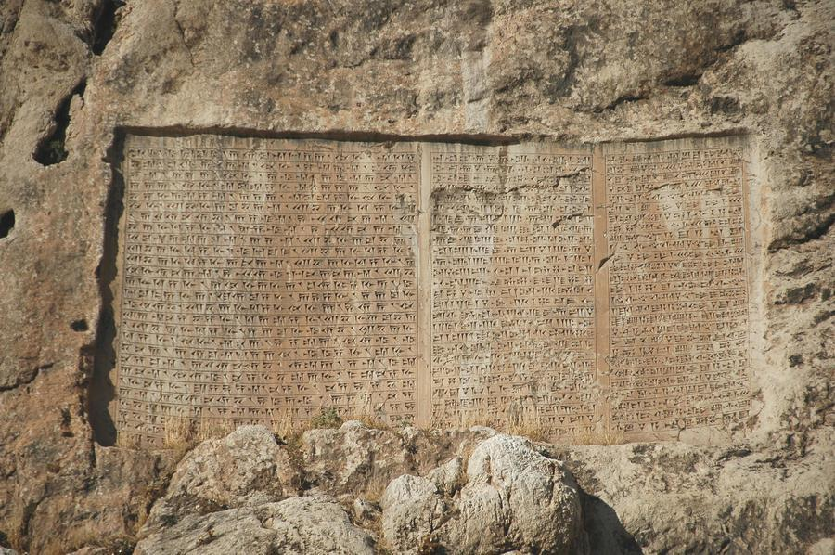
BEHISTUN INSCRIPTION : Southwestern Iran (c. 522 b.c.)
http://www.livius.org/a/turkey/van/van_XV.JPG

